Slide 1
Health and Social Care Cambridge Technicals Knowledge Organiser
Unit 4
LO3: The digestive system, malfunctions and their impact on individuals.

Slide 2
Structure of the digestive system and functions of component parts.
The digestive processes the breakdown and absorption of food and removal of the food waste products from the body.
Buccal cavity – where we put foo (mouth area) this is then chewed to break it down. Also known as the oral cavity.
Salivary glands – produce saliva and moisten food to making it easier to swallow.
Epiglottis – flap of cartilage behind the root of the tongue and covers the opening of the windpipe when swallowing food.
Oesophagus – muscular tube that connects the throat with the stomach. Food moves down through the oesophagus to the stomach. Peristalsis is a squeezing action by the muscles which helps the food move down towards the stomach.
Stomach – a sac with muscular walls that churn the food to break it up. It produces hydrochloric acid and enzymes to digest the food.
Small intestine – the duodenum. The partially digested food from the stomach known as chyme, is chemically altered by fluids from the liver and bile from the pancreas. The duodenum is lined with villi – finger-like projections in the intestinal wall that increase the surface are and assists the absorption of nutrients into the bloodstream.
Large intestine – also known as the colon reabsorbs fluids and processes waste products preparing them for them being expelled body.
Rectum – last part of the colon and links to the anus. Stores faeces until it can be excreted from the body.
Anus – the opening that faces is excreted from. The process is know as defecation. The anal sphincter muscle controls the opening and closing of the anus.

Slide 3
Structure and function of the digestive system.
Salivary Gland:
Produces saliva to moisten food, making it easier to swallow
Pharynx
Mouth:
Breaks up food particles.
Oesophagus
Mouth
Liver:
Breaks down toxins and old blood cells. Stores vitamins and iron.
Stomach
Gall Bladder:
Concentrates bile which aids digestion.
Large Intestine:
Reabsorbs more water and ions from the partially digested food. Creates faeces(waste products) from what remains.
Pharynx:
Swallows food.
Oesophagus
Transports food from throat to stomach.
Large Intestine
Rectum
Stomach:
Muscular walls churn the food. Produces enzymes that break up the food and hydrochloric acid to activate the enzymes. Uses pepsin to digest some protein.
Appendix
Anus
Small Intestine:
Completes digestion of partially digested food. Absorbs some nutrients, using sucrase to digest sugars, amylase to digest polysacharrides and peptidase for protein. Also absorbs most of the water from the blood.
Rectum:
Stores and then expels the faeces.
Pancreas:
Uses hormones to regulate blood sugar levels. Uses bicarbonates to neutralise acid from the stomach. Uses amylase to digest polysaccharides, lipase to digest lipids and trypsin chymotripsin for protein.
Anus:
Faeces is expelled from this opening.

Slide 4
Mechanical and Chemical digestion.
Mechanical Digestion:
Mechanical digestion is when food is physically broken down to make it smaller:
Chewing – teeth break down large pieces of food into smaller ones that can be swallowed.
Stomach – churns food to break it down
Small intestine – the bile emulsifies lipids (breaks into small particles). Lipids are also known as fats.
Chemical Digestion:
Chemical digestion is where nutrients are broken down by enzymes to smaller molecules that can be absorbed into the blood and used by cells.
Buccal cavity - food dissolved with saliva that contains an enzyme called amylase.
Stomach = mixes food with enzymes and hydrochloric acid whilst churning it.
Chemical digestion of proteins – broken down by pepsin in the stomach and small intestine.
Ingestion:
Food is taken into the body via the mouth.
Absorption:
Food passes through the intestine walls into the bloodstream.
Elimination: The undigested waste is removed from the body.
Digestion:
Physical and chemical breakdown of food (chewing & enzymes.
Digestive roles of the pancreas and liver.
Digestive role of pancreatic juice:
Pancreas produces digestive enzymes that are released into the small intestine in pancreatic juice.
Pancreatic juices that are released into the duodenum help the body digest fats (lipids).
Pancreatic juices are released into a system of ducts that culminate in the main pancreatic duct.
Digestive role of Bile:
Bile is a digestive juice produced by the liver.
Helps the body absorb fat into the bloodstream.
Stored in the gallbladder until the body needs it to digest fats.
Enters the small intestine through the bile duct.
Bile emulsifies fats and neutralizes stomach acid.
The digestive process:

Slide 5
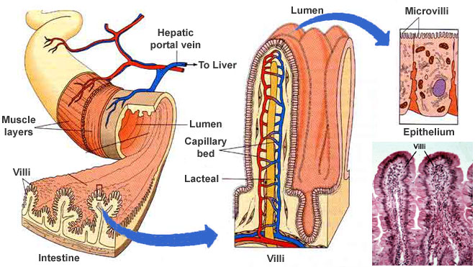
Absorption and assimilation
Adaptations of the intestinal wall for absorption:
Absorption refers to how the nutrients extracted from food are absorbed into the bloodstream. This takes place in the small intestine.
Villi and microvilli increase the surface area of the small intestine wall to make absorption more efficient.
Villi contain blood vessels and lacteal.
Products of fat digestion enter lacteal.
Nutrients enter by diffusion.
Everything else enters the blood.
Lacteal
Lymphatic capillaries that absorb dietary fats in the villi of the small intestine.
The role of the live in assimilation:
Assimilation is the movement of digested food molecules into the cells of the body where they are used, they become part pf those cells.
Excess glucose in the blood reaching the liver is converted into glycogen to be stored or broken down through respiration, producing energy.
The liver is where toxins like alcohol are broken down.
Digestive malfunctions and possible causes and effects on an individual.
Irritable bowel syndrome:
Symptoms:
Stomach pains and cramping.
Changes in bowel habits i.e. constipation, diarrhea or both.
Bloating and swelling of the stomach.
Excessive wind (flatulence)
Sudden need to go to the toilet.
Feeling like bowels have not fully emptied after going to the toilet.
Passing mucus from the anus.
Biological explanation:
Food moves quickly through the digestive system too quickly or slowly with irritable bowel syndrome (IBS). If food moves too quickly it causes diarrhea as not enough water is absorbed by the intestines. If it moves too slowly, constipation is the result as too much water is absorbed by the intestines, making faeces hard.
There may also be problems with the absorption of bile during the digestive process and may cause IBS in some cases.
Small intestine and cross section of villus.

Slide 6
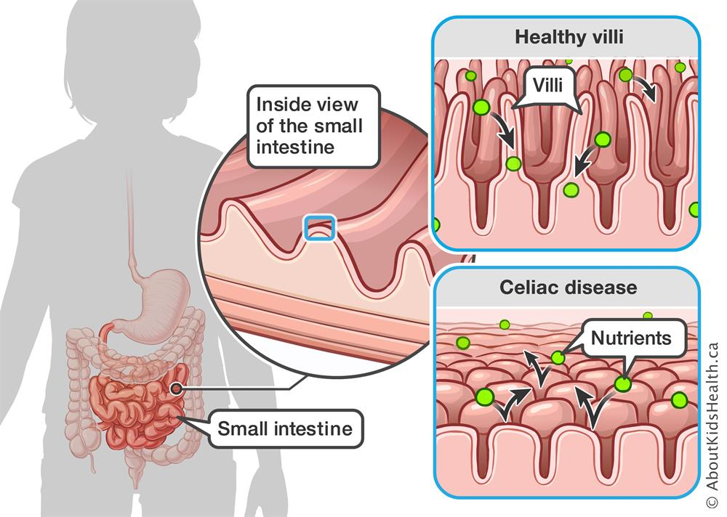
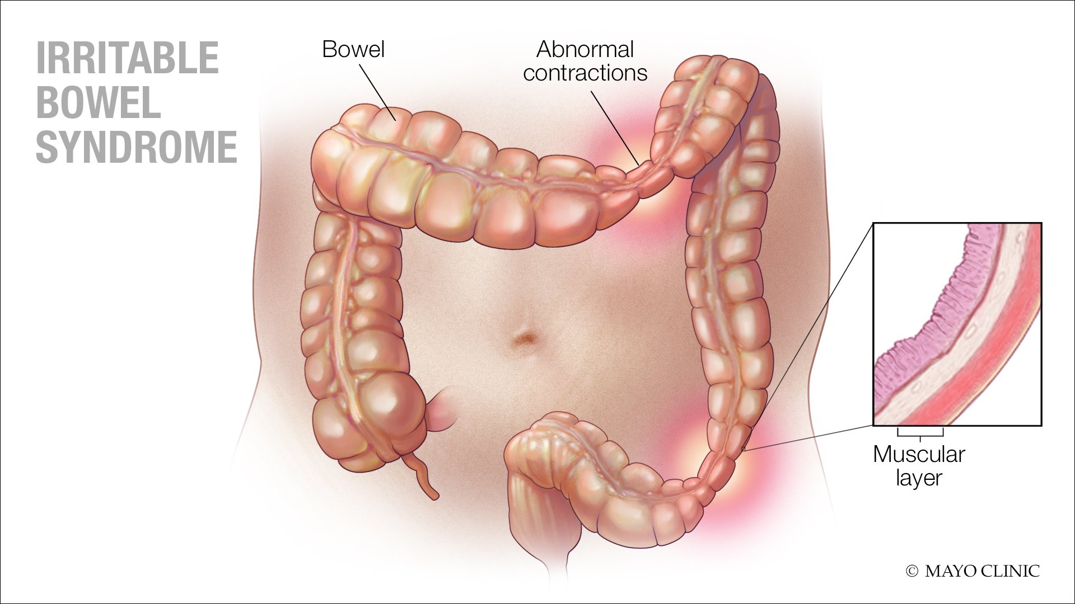
Digestive malfunctions and possible causes and effects on an individual.
IBS Continued….
IBS is linked to the increased sensitivity of the gut to certain foods and also related to problems with digesting food.
For many sufferers, symptoms are triggered by something they have eaten or drank. Changes in lifestyle and diet can help manage and control the condition.
Autoimmune condition – an illness that occurs when the body tissues are attacked by the body’s own immune system. The body attacks and damages it’s own tissues.
Coeliac disease
Coeliac disease:
Symptoms:
Indigestion, stomach pain, bloating, wind, diarrhea, constipation, anaemia and loss of appetite.
Fatigue – feeling tired all of the time, this is a result of malnutrition.
Child development – physical growth not at the expected rate or adults experiencing unexpected weight loss.
Biological explanation:
It is an autoimmune condition this means the immune system that fights infection, mistakes part of the body as a threat and attacks it. The immune system mistakes gliadin (substance found in gluten) as a threat to the body – so attacks it. This causes damage to the villi in the small intestine. The antibodies cause the surface of the intestine to become inflamed and the villi are flattened, this means the body’s ability to absorb nutrients is disrupted.
Villi usually help nutrients from food to be absorbed through the walls of the small intestine and into the bloodstream. Coeliac diseases is not a food allergy or a gluten intolerance it is an autoimmune response – where healthy substances are mistaken for harmful ones by the body and antibodies are produced to fight them.
Causes:
Often runs in families – if there is a close relative with the condition the chances of an individual developing it is higher.
Research has linked it to a number of genetic mutations that affect a group of genes. (HLA-GQ genes) – responsible for development of the immune system. However, it is common and environmental factors trigger the condition in certain people.
Evidence has shown that the introduction of gluten into a baby’s diet before six months may increase their risk of developing the condition.

Slide 7
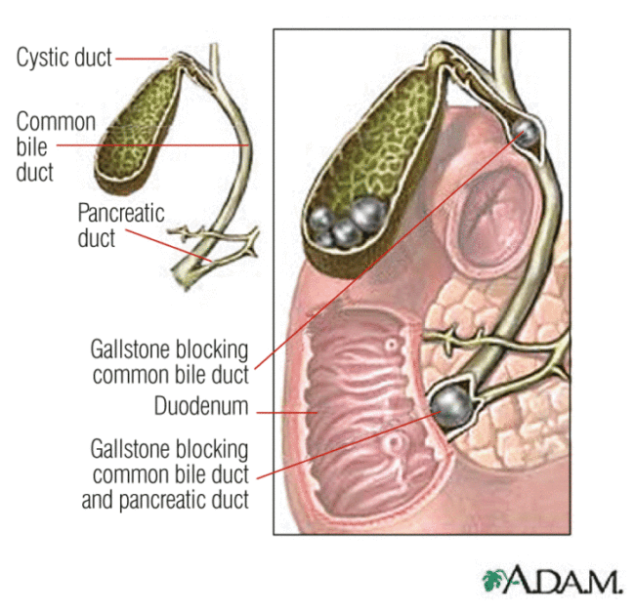
Gallstones
Symptoms:
Abdominal pain – can be sudden and severe.
Nausea, vomiting and excessive sweating.
Jaundice – yellowing of the skin and whites of eyes.
Itchy skin.
Diarrhoea.
Loss of appetite.
Biological explanation:
Gallstones can form if:
There are unusually high levels of cholesterol inside the gallbladder.
There are unusually high levels of waste products called bilirubin inside the gallbladder.
These chemical imbalances cause tiny crystals to develop in the bile. These can gradually grown into solid stones that can be as small as a sugar crystal or as large as a pebble.
Sometimes only one stone will form, often several develop at the same time.
Monitoring malfunctions: monitoring treatment and care needs:
A variety of methods can be used to check, test, monitor and treat a person’s digestive functions and also to diagnose and asses their condition.
Ultrasound:
Can be used to examine the liver and other organs in the abdomen and pelvis. A lubricating gel is used on the skin to allow smooth movement of the hand held probe. It is moved over the body part that is being examined – sound waves bounce back off the body tissues, forming images on the monitor screen.
Gastroscopy:
Using an endoscope –examines the oesophagus, stomach and duodenum. The procedure uses a long flexible tube called an endoscope. The tube has a light and video camera at one end. Endoscopes are inserted into he body via the mouth or anus. It can be uncomfortable – local anaesthetic spray is used in the throat. The procedure takes approximately an hour and used to investigate symptoms like abdominal pain or difficulty swallowing.
Cholangiography:
This procedure can be used to give further information about the condition of the gallbladder. A cholangiography uses a dye that shows up on X-rays. The dye may be injected into the bloodstream or into the bile ducts during surgery or using an endoscope. X-rays are taken and reveal any abnormality in the bile or pancreatic system.
Causes:
Caused by a chemical imbalance in he make up of bile in the gallbladder.
More common if a person is overweight or obese and in the their 40’s or over, may have an underlying condition that affects the flow of bile. (i.e. cirrhosis of the liver, Chron’s disease or IBS).
If a close family member has had gallstones – there may be more of a chance of an individual developing them too.

Slide 8
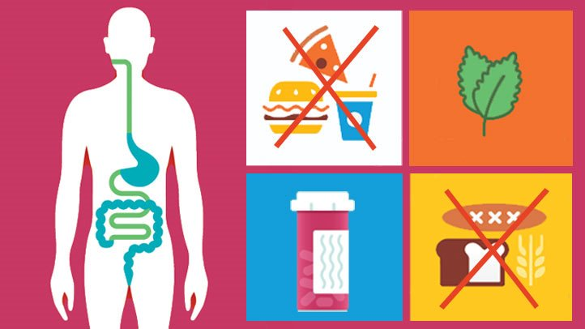
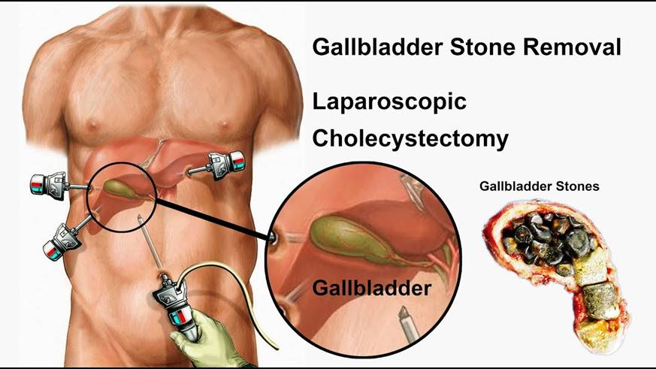
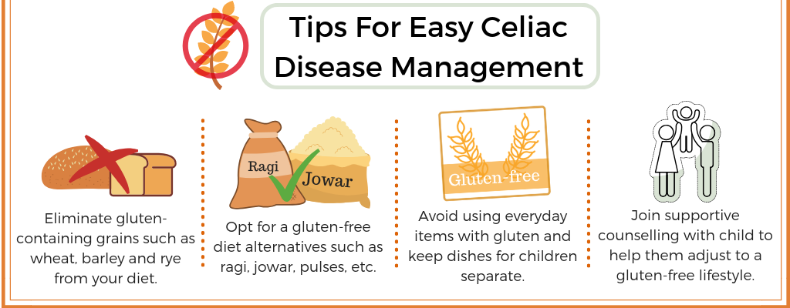
Treatment
Treatment for IBS:
To avoid diarrhoea:
Cut down on high fibre foods like; wholegrain foods – brown bread and brown rice, nuts and seeds.
Avoid eating foods that contain the sweetener sorbitol.
To avoid bloating:
Avoid foods that are hard to digest, such as, cabbage, broccoli, cauliflower, beans, onions and dried fruits.
Eat up to one teaspoon of linseeds a day.
Treatment for gallstones:
This is on a case to case basis and based on how the symptoms are affecting the individual’s life day to day.
An individual with no symptoms would be actively monitored – meaning the individual does not receive immediate treatment, but should let their GP know if they begin to have symptoms. If for example bile ducts become blocked causing pain and nausea – treatment will be needed.
Key hole surgery is carried out should the gallbladder need to be removed.
Medication – it is possible to take tablets to dissolve small gallstones, however, they are not often prescribed as they are not very effective. They have to taken for a long period of time (up to 2 years) and gallstones can reappear when medication is stopped.
Lithotrispy – a non-surgical treatment where a tiny endoscope probe is used to deliver shockwaves that shatter the gallstones. The camera on the endoscope allows the surgeon to see the gallstones shattering.
Treatment for Coeliac Disease:
Stop eating foods that contain gluten for life to prevent long-term damage to health.
Ensure you have vaccinations, i.e. the flu vaccine, because with coeliac disease are more vulnerable to infection.
Vitamin and mineral supplements can help to improve and overcome any dietary deficiencies.
Tips for easy coeliac management

Slide 9
Impact on diet and lifestyle:
IBS:
Abdominal pain and discomfort from bloating can hamper sleep = fatigue and emotional frustration.
Regular visits to the toilet restricting socializing and trips out etc.
Diet restricted, can make socializing tricky or embarrassing as they may not be able to eat and drink the same as their friends.
Coffee and fizzy drinks can cause irritation of the gut – avoid them!
Try and avoid stressful situations (not always easy)
Record foods in a food diary to identify those that cause irritation or pain. Regular exercise – can relieve stress and increase feeling of wellbeing.
Coeliac Disease:
Exclude gluten (wheat products) from the diet or villi will be damaged.
Take vitamin and mineral supplements (due to impaired absorption)
Read food labels carefully (flour can be added as a thickener)
Take care when eating out. – it should state on the menu.
Avoid using oil that has fried foods with gluten in.
Gallstones:
The gallbladder is not an essential organ – can lead a normal life without one.
After surgery to remove the gallbladder some may experience bloating etc. after spicy or fatty food – advised to avoid those types of foods.
Health balanced diet eating a variety of foods and having regular meals. Eatwell guide is recommended.
Exam Tips:
Read the questions carefully.
Practice labelling the digestive system diagram – you might get asked to label a similar diagram in the exam.
Make sure you know the biological explanations, symptoms and causes for each digestive system malfunction.
Give specific examples using the correct terminology when answering the questions.
Questions might ask you to identify ways of monitoring conditions, symptoms, treatments and or impacts of conditions – make sure you know what you are being asked for! - Be careful – if you give examples of treatments when you were asked for symptoms – you will not gain any marks.
Suggested revision activities:
Write the nine structures of the digestive system onto small bits of paper. Put them in a container and with a friend take it in turns to pull one out and explain the function.
Use the digestive process diagram on Page 3 of the KO and extend it by adding as much detail as you can about the digestive system.
Create cue cards on and create key fact cards about malfunctions.
Common errors made:
Don’t get confused by he different parts of the digestive system and other systems, for example confusing the trachea and the oesophagus.
Make sure you know the difference between mechanical and chemical digestion – differences have to be clear.
Confusing Coeliac Disease and IBS – be clear on the meaning and implications.

